Slide 1
Team Lavender
Pitch Deck
Mustafa Poonawala (msp9471),
Yash Jadhav (yj3076)

Slide 2
Business Understanding
01

Slide 3
The Business Problem
Client: Banca Massiccia
The client, Banca Massiccia, is a large Italian bank seeking to reduce losses from bad loans. Their goal is to get better predictions of the one-year probability of default (PD) for corporate borrowers.
This project solves three distinct problems for the bank:
Financial Problem: The bank aims to implement true risk-based pricing. Without a reliable and calibrated PD, they cannot accurately price credit risk, which leads to financial losses from under-pricing risky borrowers and opportunity costs from over-pricing safe borrowers who then move to competitors.
Operational Problem: Although statistical methods are used, the current underwriting process still depends heavily on human judgment and manual review, making it slow, subjective, and difficult to reproduce consistently. The bank needs an automated, objective, and consistent PD-generation tool to support faster and more reliable decision-making.
Regulatory Problem: International accounting standards such as IFRS 9 require banks to calculate Expected Credit Loss (ECL), a formula that mandates a statistically valid and properly calibrated PD. Compliance with these standards is non-negotiable, making a robust PD model essential for accurate provisioning and regulatory reporting.
Goal: Predict 1 Year Probability of Default (PD)
Financial Problem: Need Reliable PD for Risk-Based Pricing
Operational Problem: Heavy Human Judgment, Slow and Inconsistent
Regulatory Problem: IFRS 9 Requires Calibrated PD for ECL

Slide 4
How Our Solution Precisely Addresses the Problem
A simple "approve/deny" (classification) model would fail to solve the bank's problem. They don't just need a ranking; they need a real, usable probability.
Our solution is a two-stage, finance-aware pipeline that delivers the exact, usable PD the bank requires.
Stage 1: XGBoost Risk Engine: We use an XGBClassifier to ingest our 12 final financial features (like altman_z and cfroa_w). This model excels at finding the complex, non-linear risk patterns that traditional models miss, achieving a high discriminatory power (AUC: 0.837).
Stage 2: Isotonic Calibration: This is our key differentiator. The raw XGBoost score is not a real probability. We feed that score into our custom PDModel Calibrator (which uses Isotonic Regression) to convert it into a true, reliable PD.
This two-stage model directly solves all three business problems:
The calibrated PD is the direct input for their ECL and risk-based pricing formulas.
The entire pipeline is automated in harness.py, solving the slow, manual operational problem.
Stage 1A:
XGBoost Risk Engine
Stage 1B:
Ingest Financial Features
Stage 1C:
Find Non Linear Risk Patterns
Stage 2:
Regression Calibration
Converts Raw Score → True PD
Notes:
Cash Flow Stability/Volatility
Deakin, E. B. (1972). A Discriminant Analysis of Predictors of Business Failure. Journal of Accounting Research. https://doi.org/10.2307/2490225
Charitou, A., Neophytou, E., & Charalambous, C. (2004). Predicting Corporate Failure: Empirical Evidence for the UK. European Accounting Review. https://doi.org/10.1080/0963818042000216811
Asset Structure and Debt Structure
Myers, S. (1977). Determinants of Corporate Borrowing. Journal of Financial Economics. https://doi.org/10.1016/0304-405X(77)90015-0 Shows that tangible assets support debt capacity and reduce distress risk.
Diamond, D. (1991). Debt Maturity Structure and Liquidity Risk. Quarterly Journal of Economics. https://doi.org/10.2307/2937924 Demonstrates how short-term debt increases rollover/refinancing risk, raising default probability.

Slide 5
Our Hybrid Approach vs. Past Work
Our approach is a hybrid that is superior to both the traditional finance and the "ML-only" methods, which both fall into critical traps.
Traditional Finance Approach (e.g: Logistic Regression): This is the long-standing industry standard.
Good Idea We Kept: Traditional models are grounded in financial theory. We preserved this strength by engineering finance-aware variables, such as the Altman Z-score, as core inputs.
The Trap: Logistic regression is linear. It cannot capture the nonlinear interactions that drive real credit risk (e.g., high leverage is acceptable if cash flow is strong, but dangerous when cash flow is weak).
"ML-Only" Approach (e.g: Raw XGBoost): Many modern FinTechs fall into this trap.
What They Do: They use a powerful algorithm like XGBoost to achieve high discriminatory power (e.g., AUC 0.837) and stop there.
The Trap: The model remains a black box, and its raw scores are uncalibrated. Without calibration, the output cannot be used for pricing or IFRS-9 ECL calculations. They build a strong engine but do not connect it to the controls the bank actually needs.
Our Hybrid Approach: Our Solution combines the strengths of both worlds.
Accuracy: We use XGBoost to capture the complex, non-linear relationships that traditional models miss.
Interpretability: We restrict the model to only 12 finance, aware features, preserving transparency and avoiding “feature bloat.”
Business Usability: We add the PDModel Calibrator, converting raw XGBoost scores into a true, reliable, calibrated PD suitable for pricing, ECL, and regulatory reporting.
This “last-mile” step is what makes our PDs not only accurate but also actionable for the bank.

Slide 6
02
Problem Formulation
Section Overview
Define what “default” means in our dataset and how we constructed the 12-month prediction target.
Specify the prediction horizon the bank cares about and align the setup with how financial data becomes available in practice.
Structure the data so the model learns from information that would realistically be known at underwriting time.
Incorporate financial intuition to ensure the model captures economic drivers of distress rather than patterns in raw accounting values.

Slide 7
Defining the Prediction Problem
Goal : Estimate the probability that a borrower will default within the next 12 months using only the financial information that would have been available at the time of the lending decision.
How we defined the prediction task
Firms in Italy typically publish approved financial statements 120–180 days after fiscal year-end
To reflect this reporting lag, we defined an “available date” = statement date + 4 months.
A firm-year is labeled as a default if a default event occurs within 12 months after this available date.
This means the model predicts from “available date → 12 months ahead,” not from December to December, ensuring the prediction window reflects real underwriting timing.
This comes under a Supervised Learning Task where the model will learn to predict default based on the given financial variables of a given year and the target variable that i.e whether a firm will default or not within a year.
Why this setup matters
Aligns the model with the bank’s operational question:
“Given the information available today, what is the default risk over the next year?”
Avoids look-ahead bias and prevents the model from benefiting from future information.
Produces predictions suitable for real-world lending, pricing, and risk-management use.

Slide 8
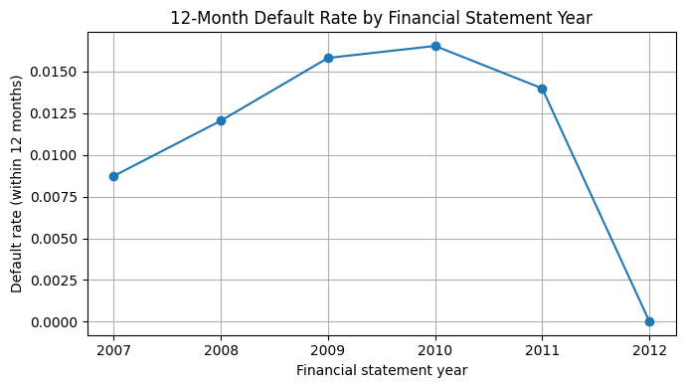
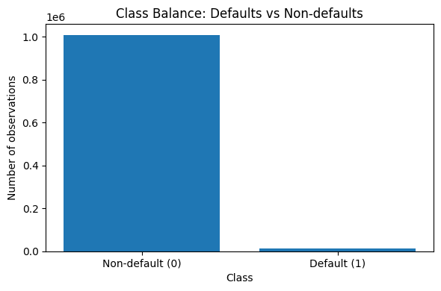
Figure 1
Figure 2
Figure 1: 12-month default rate by financial statement year. The default rate rises through 2009–2010 and declines afterward. The overall default rate in the dataset is 1.09%.
Figure 2: Class distribution of the target variable. The dataset is highly imbalanced, with 1,009,771 non-default observations and 11,156 defaults.

Slide 9
Importance of Financial Theory
Why not use raw financial statement values?
Raw items (assets, liabilities, revenues) scale with firm size and are not comparable across firms.
Default risk is tied to economic conditions, solvency, liquidity, profitability, not the absolute magnitude of balance-sheet items.
Financial ratios normalize values and reveal structural relationships that theory links to distress.
What the academic literature shows
Altman (1968): Liquidity, leverage, and profitability ratios discriminate strongly between bankrupt vs. non-bankrupt firms.
Ohlson (1980): Leverage, liquidity, and performance ratios are statistically significant predictors of corporate failure.
Implication for our model
Ratio-based features expose the economic signals associated with credit deterioration (indebtedness, cash sufficiency, earnings power).
Ratios reduce noise and size effects, enabling the model to learn meaningful, generalizable patterns rather than firm-size artifacts.

Slide 10
Incorporating Financial Intuition
We structured our feature engineering around five financial dimensions that prior empirical studies have consistently linked to corporate default risk.
Leverage and Solvency :
When leverage is high (more debt relative to equity), a small decline in earnings can wipe out equity → PD increases.
Strong equity and lower leverage give a bigger loss-absorbing buffer → PD decreases.
Profitability & Returns
Low or negative profitability means the firm cannot generate enough internal cash to service debt and invest → PD increases.
Higher, stable returns (ROA, ROIC, margins) indicate stronger earnings power and resilience to shocks → PD decreases.
Liquidity & Debt-Service Capacity
Weak liquidity (low cash, low cash-to-assets, low interest-coverage) means even a temporary shock can cause missed payments → PD increases.
Ample liquid assets and comfortable interest coverage give the firm room to absorb timing mismatches in cash flows → PD decreases.
Notes:
For Leverage and Solvency
Altman, E. I. (1968). Financial Ratios, Discriminant Analysis and the Prediction of Corporate Bankruptcy. Journal of Finance. https://doi.org/10.1111/j.1540-6261.1968.tb00843.x
Ohlson, J. A. (1980). Financial Ratios and the Probabilistic Prediction of Bankruptcy. Journal of Accounting Research. https://doi.org/10.2307/2490395
For Profitability and Returns and Liquidity and Debt Service Capacity
Beaver, W. (1966). Financial Ratios as Predictors of Failure. Journal of Accounting Research. https://doi.org/10.2307/2490171

Slide 11
Incorporating Financial Intuition
Cash-Flow Stability / Volatility
Highly volatile or consistently low operating cash flow makes it harder to meet fixed obligations in bad periods → PD increases.
Stable, predictable operating cash flows support regular debt service and reduce reliance on external financing → PD decreases.
Asset Structure & Debt Structure
A low share of tangible assets limits collateral and recovery value; heavy reliance on short-term debt raises refinancing risk → PD increases.
More tangible, pledgeable assets and a higher share of long-term debt reduce rollover risk and improve recovery prospects → PD decreases.
These dimensions guided which ratio families we created and ultimately supported our selection of the 12 final features used in the model.
Notes:
Cash Flow Stability/Volatility
Deakin, E. B. (1972). A Discriminant Analysis of Predictors of Business Failure. Journal of Accounting Research. https://doi.org/10.2307/2490225
Charitou, A., Neophytou, E., & Charalambous, C. (2004). Predicting Corporate Failure: Empirical Evidence for the UK. European Accounting Review. https://doi.org/10.1080/0963818042000216811
Asset Structure and Debt Structure
Myers, S. (1977). Determinants of Corporate Borrowing. Journal of Financial Economics. https://doi.org/10.1016/0304-405X(77)90015-0 Shows that tangible assets support debt capacity and reduce distress risk.
Diamond, D. (1991). Debt Maturity Structure and Liquidity Risk. Quarterly Journal of Economics. https://doi.org/10.2307/2937924 Demonstrates how short-term debt increases rollover/refinancing risk, raising default probability.

Slide 12
Why Our Approach Outperforms Raw Data Mining
1. Translates accounting data into risk-relevant signals
Ratios explicitly capture solvency, liquidity, profitability, and cash-flow strength, core economic drivers of default.
Raw values do not reflect these mechanisms.
2. Encodes causal structures found in credit-risk research
Capital structure, earnings volatility, and cash-flow coverage have been repeatedly validated as predictors of distress.
Ratio-based features allow the model to learn from these relationships.
3. Reduces overfitting and improves generalization
Raw accounting values vary widely across industries and firm sizes.
Ratios stabilize scale differences and produce features that behave consistently across the dataset.
4. Supports interpretability and model credibility
Ratios provide intuitive explanations (“PD increases when leverage rises”).
Interpretability is essential for governance, validation, and risk-management use cases.
5. Aligns the prediction task with real underwriting constraints
By using financially normalized, theory-driven features, the model is more aligned with how risk is assessed and therefore more deployable.
Key references
Altman (1968), Ohlson (1980), Beaver (1966),

Slide 13
03
Data Understanding
Section Overview
In this section we,
Describe the dataset provided by Banca Massiccia, what each firm-year row contains, the types of financial statement variables included, and the overall structure and coverage of the data.
Identify data quality issues relevant for modeling, including missing values, variables with limited availability, and patterns in missingness between defaulting and non-defaulting firms.
Explain which variables were viable for constructing financial ratios and which were excluded, based on completeness, stability, and economic relevance, setting the foundation for later feature engineering.

Slide 14
Dataset Summary
Dataset provided by Banca Massiccia:
Annual financial statement data for Italian firms, provided at the firm-year level.
Each row represents one firm in one fiscal year (“firm-year”) and this is our unit of analysis.
Contains 44 financial statement variables (assets, debt, revenues, profitability measures, cash flow items, etc.) plus identifiers (id, sector, legal structure, city).
All monetary quantities are reported in thousands of euros, as specified in the original documentation.
Coverage includes only:
Firms with > €1.5M in assets
Non-financial industries
The training dataset includes historical default dates up to 12/31/2012.
The holdout dataset contains the same structure but no default labels.
What this means for modeling
The dataset provides the raw accounting variables required to construct financial ratios (e.g., leverage, profitability, liquidity), but not all line items are equally complete or consistently available.
Each firm appears across multiple years, with varying lengths of history.

Slide 15
The Target Variable Challenge
Potential Biases & Limitations
The single most problematic aspect of the raw data is the lack of a target variable.
We were not given a simple "Default = 1 / No-Default = 0" column.
We were only given def_date, which is just a date.
Problem: To build a 12-month prediction model, we must create a target variable by looking forward 12 months from a given fs_year.
Business Insight (The Lag): We must also account for the Information lag. A financial statement from fs_year2008 is not published and available to the bank until several months later.
Conclusion: This understanding that our target is not given and that we must account for a time lag is the single most important finding. It directly motivates the way we setup the problem as explained in the problem formulation.
The data is not a random sample of all businesses. It has severe, known biases that strictly limit our model's scope:
1. Size Bias: The data excludes all firms with < €1.5MM in assets. This is a major sampling bias. Our model will have no knowledge of small businesses or startups.
2. Industry Bias: The data excludes all finance and insurance firms. Their balance sheets are fundamentally different, so our model is only valid for non-financial corporations.
3. Geographic Bias: The data is from Italian firms only. The financial patterns it learns are specific to the Italian economy and cannot be applied to other countries.
4. Temporal Limitation: The training data for defaults ends in 2012. This means the model has not been trained on recent economic events (e.g., a post-2012 high-interest-rate environment), which creates a risk of model drift.

Slide 16
Inherent Data Quality Problems
Finally, we understood from the raw train.csv that the data was "dirty" and presented three classic data mining challenges:
Severe Class Imbalance (Problematic): Defaults are rare events. The raw data has a very low percentage of default (1s) vs. non-default (0s). This is problematic because a naive model will just predict "0" for everyone and achieve high accuracy. This understanding motivates our choice to use scale_pos_weight in the modeling step.
Extreme Outliers (Problematic): Financial ratios (like ROE) are famously "noisy." A firm with tiny equity can have an ROE of +50,000%. These extreme values are not real economic signals; they are mathematical noise that can break a model. This understanding motivates our "Winsorization" step in Data Preparation.
Pervasive Missing Data (Problematic): Many firms had NA for key financial items. Simply dropping these rows would have destroyed thousands of samples. This understanding motivates our imputation and feature engineering in Data Preparation.
Evidence from the data:
Return on Equity (roe): Missing for only 6.5% of non-defaulting firms, but missing for a staggering 44.3% of defaulting firms.
Financial Margin (margin_fin): Missing for only 3.5% of non-defaulting firms, but missing for 34.0% of defaulting firms.
Debt Variables (e.g., debt_fin_st): Showed moderate missingness (around 14%) for defaulted firms, further indicating distress.
Conclusion: Because of this imbalance, we decided that dropping rows wasn’t a viable option, and would have to construct ratios and missing values to ensure a PD prediction for all types of data.

Slide 17
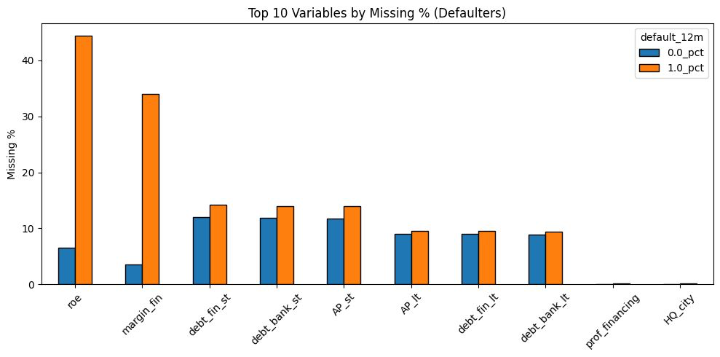
Figure 3: Plots the % of Missing Values Between Defaulters and Non Defaulters

Slide 18
04
Data
Preparation
Section Overview
In this section we cover
How core accounting quantities were reconstructed → Rebuilding assets, liabilities, and equity from components when reported values were missing.
How missing and inconsistent values were handled → Identifying gaps, applying targeted imputations, and ensuring consistency across firm-years
How financial ratios were constructed from cleaned inputs → Using reconstructed balance-sheet and income-statement items as stable denominators and numerators
How final features were normalized and bounded for modeling → Winsorizing/extreme-value clipping to reduce noise and improve model stability

Slide 19
Reconstruction of Core Accounting Quantities
Objective: Ensure core accounting values were complete and internally consistent before constructing ratios.
What we found in the raw data:
Some core balance-sheet components had non-trivial missingness (e.g., debt_bank_st, debt_fin_st, AP_st, AP_lt, liab_lt).
Total assets had no missing values; total equity had 1 missing value, but all these fields are essential inputs for nearly every ratio.
Even when high-level totals were present, the subcomponents were sometimes missing, so totals were not always internally consistent.
Missingness patterns differed by default status, which could bias ratios that depend on these fields.
Why this matters
Ratios such as leverage, liquidity, profitability, debt structure, and cash-flow capacity all depend on accurate totals.
If these base quantities were inconsistent or partially missing, the ratios would be unstable and distort the model.

Slide 20
Reconstruction of Core Accounting Quantities
Reconstructed core accounting quantities
Total assets reconstructed as: Intangible Asset + Tangibles Asset + Financial Fixed Assets + Current Assets, replacing asst_tot only when missing
Short-term and long-term debt reconstructed using bank and non-bank components (debt_bank_st, debt_fin_st, debt_bank_lt, debt_fin_lt).
Total liabilities reconstructed from : Long Term Liabilities + total debt + AP + employee liabilities.
Equity reconstructed where missing using the accounting identity: Total Equity = Total Assets - Liabilities
How reconstructed values were applied
Whenever a total (e.g., asst_tot, debt_lt, debt_st, eqty_tot) was missing, the reconstructed value replaced the original.
If both the component and total were missing, the value was set to 0, preventing missing errors and ensuring uniform feature construction.

Slide 21
Handling Missing and Extreme Values
Handling Missing Inputs in Ratio Construction
Mean or median imputation was avoided because it would artificially create firms with “average” characteristics they never reported.
Missing accounting components were set to generally set to 0 the absence has a clear economic interpretation (e.g., no reported debt, no cash in a subcategory, or unreported AP/AR).
The variables used to construct ratios exhibit relatively low missingness, so imputing with averages would have disproportionately influenced the resulting ratios.
Using zero in these cases maintains numerical continuity while remaining consistent with the interpretation of “low or absent” amounts.
Ratios derived from these inputs were subsequently clipped at percentile bounds to limit the influence of extreme observations.
How Extreme Values Were Handled
Every ratio was clipped/winsorized using the 1st and 99th percentiles: To prevent unrealistic values like ROE = +50,000% or interest coverage > 1e6.
Stored parameters used to transform the test/holdout set: Ensures exact same winsorization boundaries are applied and prevents information leakage.
Standardization applied where needed (e.g., CF_to_Debt) : Mean and std of the training distribution stored in details and applied later to score new observations consistently.

Slide 22
List of Financial Ratios Used
Leverage : Total liabilities ÷ total assets - Shows how much of a company’s assets are financed by liabilities.
ROA : Operating profit ÷ total assets - Shows how much of a company’s assets are financed by liabilities.
Cash Flow Return on Assets (CFROA): Operating cash flow ÷ Total Assets - Shows how effectively the firm’s assets generate operating cash flow.
Tangible Asset Ratio: Tangible fixed assets ÷ Total Assets - Shows how much of a company’s assets are financed by liabilities.
Long Term Debt Ratio : Long-term debt ÷ Total Debt - Shows how much of a company’s assets are financed by liabilities.
Return on Invested Capital: Operating profit ÷ (Total Debt + Equity) - Measures how efficiently the company generates profit from all capital invested.
Altman Z (Simplified): 1.2 × WC/TA + 1.4 × RE/TA + 3.3 × EBIT/TA + 1.0 × Sales/TA - A composite score estimating bankruptcy risk using key financial ratios.
Cash-to-Assets: Cash & equivalents ÷ Total Assets - Shows how much of the company’s assets are held in cash or equivalents.
Financial Debt Ratio: Non-bank debt ÷ Total Assets - Measures reliance on non-bank debt relative to total assets.
Interest Coverage: EBITDA ÷ Interest Expense - Shows how easily the company can pay interest using EBITDA. (Where Ebitda is Earnings Before Interest, Taxes, Depreciation, and Amortization)
EBITDA Margin : EBITDA ÷ revenue of operations - Indicates how much of revenue remains as EBITDA.
Cash Flow to Debt : Operating cash flow ÷ total debt - Measures the company’s ability to repay total debt using operating cash flow.

Slide 23
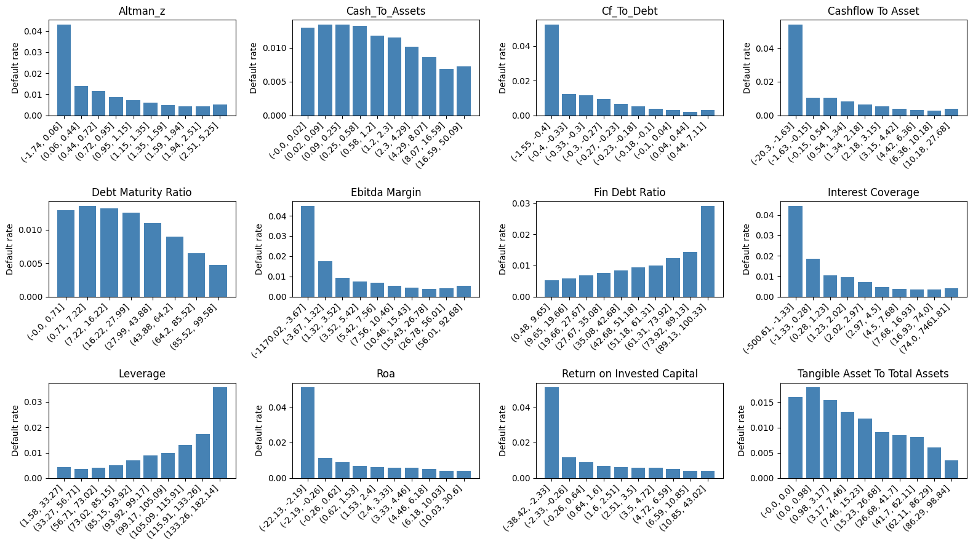
Figure 5: Illustrates the relationship between each financial ratio and the default rate. The x-axis represents the decile bins of each ratio, while the y-axis shows the corresponding default rate.

Slide 24
05
Modeling
Section Overview
Algorithm Selection: We'll cover our model choice, contrasting a traditional Logistic Regression baseline with our final, more powerful XGBoost Classifier.
Final Model Specification: Discussion on the full model specification: a two-stage pipeline that uses XGBoost for scoring and Isotonic Regression for essential probability calibration.
Feature Insights: We will discuss the 12 final features and the key economic insights the model learned, such as "cash flow is king" and the importance of debt structure.
Business Value: Finally, explaining exactly how this model solves the bank's business problem by enabling risk-based pricing, creating an early warning system, and improving efficiency.

Slide 25
Modeling: Detailed Breakdown
Type of Model(s) Built
Our final solution is not a single model but a two-stage pipeline designed to produce robust and usable probability estimates.
Stage 1: XGBoost Classifier (model.joblib) This is the core risk-scoring engine. It's an advanced, tree-based ensemble model (xgb.XGBClassifier) that ingests the 12 input features to generate an initial risk score. It excels at finding complex, non-linear patterns in the financial data.
Stage 2: Isotonic Regression Calibrator (calibrator.joblib) The raw XGBoost score is not a true, real-world probability. This second-stage model (an Isotonic Regression classifier) takes the XGBoost score and converts it into a true, calibrated probability. This calibration step is essential for the business goal of risk-based pricing, as it ensures that a 2.5% predicted PD means an actual 2.5% default rate is observed for that risk group.
Notes:
(Source: Italian Business Register italianbusinessregister.it/en/annual-accounts)

Slide 26
Choices for Data Mining Algorithm (Alternatives, Pros/Cons)
We evaluated two main algorithm families,
1. Logistic Regression (Baseline)
Pros: This is the traditional industry standard. It is highly interpretable, fast to train, and well-understood by regulators.
Cons: Its primary weakness is its assumption of linearity. It fails to capture the complex, non-linear interactions that are the essence of credit risk. For example, it cannot easily model that high leverage is only dangerous when combined with low cash flow, a pattern our final model does capture.
2. XGBoost (Final Selection)
Pros:
Captures Non-Linearity: As an ensemble of decision trees, it natively identifies complex conditional patterns. For example, it can learn that high leverage is only a high-risk factor when combined with low cash flow, a pattern logistic regression misses.
Handles Class Imbalance:It directly manages the low default rate in our data via the scale_pos_weight parameter, forcing the model to pay close attention to the rare default events.
Regularization: It has built-in regularization (like gamma and min_child_weight) that prevents the model from overfitting to noise in the financial data, making it more robust.
Cons:
It is inherently less interpretable (often as "black box") compared to logistic regression. While we can see what features are important, explaining exactly why a specific borrower received a 4.5% PD score is more complex, which can be a challenge for internal validation teams and regulators.
Notes:
(Source: Italian Business Register italianbusinessregister.it/en/annual-accounts)

Slide 27
Working of the Models
XGBoost
XGBoost is a smart prediction engine made up of many small decision trees that work together.
Each tree learns from the mistakes of the previous one, making the overall model more accurate with every step.
Instead of relying on one big model, it combines many small “weak” models into one strong, reliable predictor.
It includes built-in controls to prevent overfitting, ensuring the model stays stable and performs well on real-world data.
The final result is a probability score that reflects the likelihood of an outcome, based on patterns learned from the data.
Isotonic Regression
Isotonic regression ensures that the model’s probability scores are aligned with what actually happens in reality.
It takes the raw outputs from XGBoost and adjusts them so that, for example, a 70% prediction really behaves like a 70% chance in real-world outcomes.
It creates a smooth, ordered calibration curve that ensures higher scores always correspond to higher true risk.
This method doesn’t assume any fixed shape for the adjustment, it learns the best fit directly from historical data.
The result is more trustworthy, well-calibrated probabilities, improving decision-making where risk accuracy matters.

Slide 28
Economic Intuition for Model Results
Insight 1: Cash Flow Dominates Profit. The model learned that cash-flow-based features (like cfroa_w and cf_to_debt_std) are far more important than accounting-based profit (roa_w). This is economically sound: a firm can report accounting profits but default because it is burning through cash and cannot service its debt.
Insight 2: Debt Structure is a Key Risk. The model places high importance on debt_maturity_ratio_w. It learned that firms heavily reliant on short-term debt (which requires constant refinancing) are significantly riskier, even if their total leverage is moderate. This captures refinancing risk, a concept traditional models often miss.
Insight 3: The Altman Z-Score Remains Powerful. Our engineered altman_z feature, a classic bankruptcy indicator from 1968, was a top predictor. This confirms that its theoretically-grounded combination of working capital, retained earnings, and EBIT is still highly effective at identifying financial distress. (ACPMIP)

Slide 29
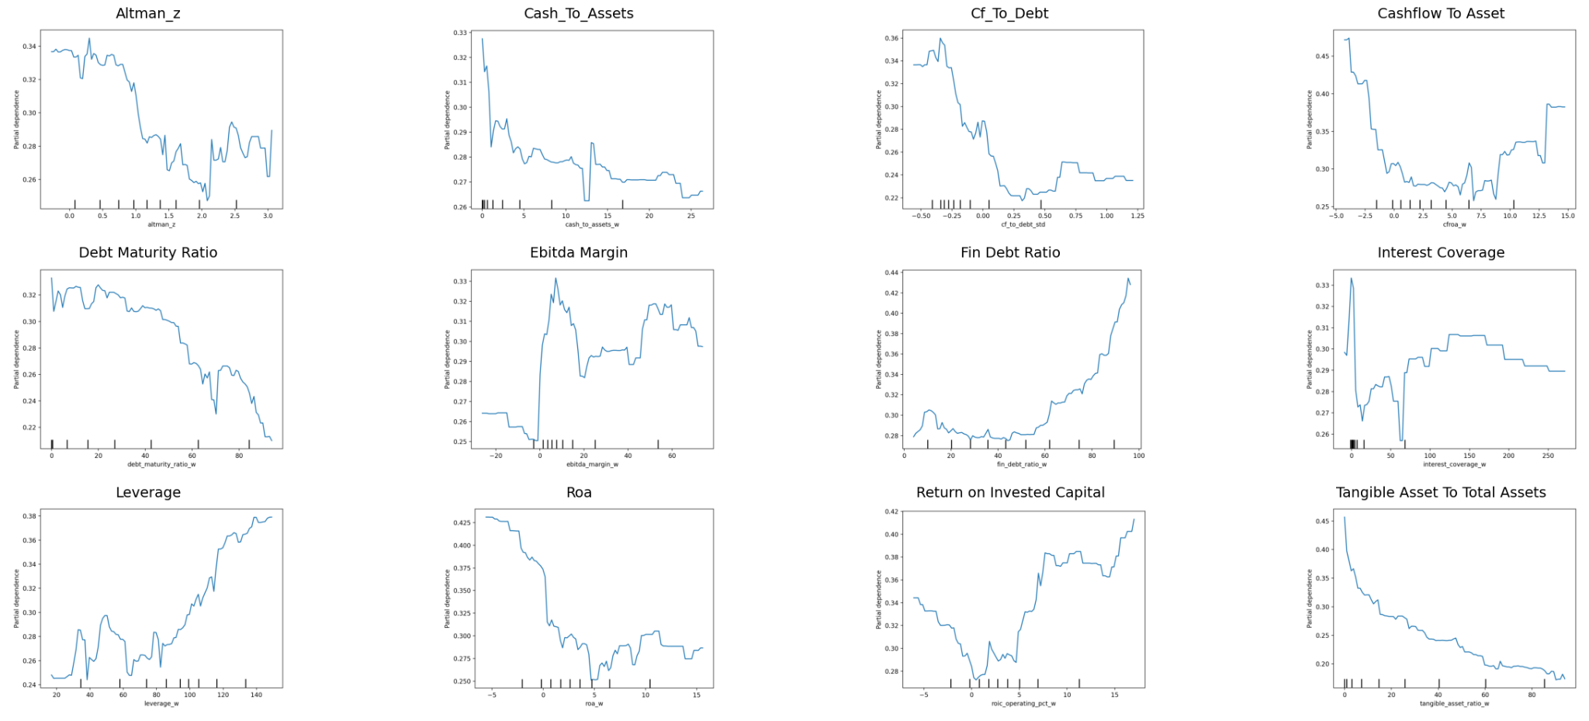
Figure 6 : Partial Dependence of the Variables on the Model

Slide 30
How the Model Solves the Business Problem
This two-stage model directly addresses the bank's core problems identified in the Business Understanding section
Enables Risk-Based Pricing (The Core Goal):
Problem: The bank wants to optimize their underwriting using Machine Learning instead of using statistical methods
Solution: Our calibrated PD output is a precise number (e.g., 0.8% vs. 5.2%). This allows the bank to move beyond a simple "approve/deny" and set interest rates that accurately reflect the risk, making them more competitive for safe clients and more profitable on riskier ones.
Operational Problem → Automated, Consistent Decisioning
Business Issue: Current underwriting is slow, manual, and subjective.
Model Solution:
The model provides a fast, fully automated PD based on objective quantitative and financial indicators.
Ensures consistent credit decisions across branches, underwriters, and time.
Frees analysts from routine cases so they can focus on high-value, complex borrowers.
Dramatically reduces turnaround time for loan approvals.
Regulatory Problem → IFRS 9–Compliant PDs:
Problem: IFRS 9 requires PDs that are clear, calibrated, and reliable for calculating Expected Credit Loss.
Solution:
The model produces PDs that are easy to check and explain.
Calibration makes sure the PDs match real default outcomes.
This leads to consistent and compliant ECL calculations.
Notes:
(Source: Italian Business Register italianbusinessregister.it/en/annual-accounts)

Slide 31
06
Evaluation
Section Overview
Validation Methodology: Will explain why a simple train/test split is wrong for this project and how our Walk-Forward Validation provides a much more realistic measure of performance.
Key Metrics: Discussing the two metrics that matter: AUC (for discriminatory power) and Brier Score (for probability accuracy), which is essential for pricing.
Performance Results: We will present the final model's strong performance (Pooled Walk-Forward AUC of 0.837) and show how it beats our baseline Logistic Regression model.
Business Case & ROI: We'll show exactly how these evaluation results translate into a tangible business case, including annual loss avoidance.

Slide 32
Evaluation: Detailed Breakdown
How the Model Was Evaluated- For a financial model like this, evaluation must be rigorous and test two separate things:
Discriminatory Power: Can the model separate good borrowers from bad ones? We measure this using AUC (Area Under the Curve).
Probability Accuracy: Is a predicted 2.5% PD really a 2.5% default rate? We measure this using the Brier Score. This is critical for the bank's business goal of pricing risk.
Given that this is temporal financial data, a simple, random train/test split would be incorrect and would lead to an over-optimistic, "leaked" result. We therefore implemented two much more robust validation methods:
Method 1: Walk-Forward Validation (Primary Method) This method simulates how the model would actually be used in production. We create expanding "folds" of time, using May-to-May windows to align with our problem formulation.
Fold 1: Train on 2000-2007 data, Test on 2007-2008 data.
Fold 2: Train on 2000-2008 data, Test on 2008-2009 data.
Fold 3: Train on 2000-2009 data, Test on 2009-2010 data.
...and so on, up to our AVAIL_CUTOFF. This shows us how the model's performance holds up over time, especially during crisis years (like 2008-2009).
This evaluation strategy follows the best-practice guidelines discussed in the course lectures and assigned readings, particularly the emphasis on temporal validation for financial-risk models, the distinction between discriminatory power and calibration accuracy, and the use of walk-forward and bootstrap methods for assessing model stability.

Slide 33
Evaluation: Detailed Breakdown
Method 2: Temporal Holdout for Calibration We held out the final 12 months (CALIBRATION_MONTHS = 12) of the training data. We used this set to:
Train the PDModel Calibrator (Isotonic Regression).
Evaluate the model before and after calibration to ensure Brier Score (accuracy) improved without hurting AUC (discrimination).
Method 3: Bootstrap Confidence Intervals To ensure our AUC scores were statistically significant and not just a fluke, we ran bootstrapping with 2,000 resamples. This gives us a 95% confidence interval for our final performance metrics.
Benchmarks and Performance Analysis
We benchmarked our final XGBoost model against two key alternatives:
Benchmark 1: Baseline Logistic Regression: Our final model significantly outperformed the traditional logit model that was trained on the same dataset. The baseline Logistic Regression achieved an AUC of 0.8120, whereas our final calibrated XGBoost model achieved a superior AUC on a comparable holdout set.
Benchmark 2: The Uncalibrated Model: We benchmarked our final calibrated model against its uncalibrated version.
Brier Score: The calibration step improved the Brier score (lower is better) from 0.136 to 0.0119, a significant improvement in probability accuracy.
AUC: The calibration also improved the discriminatory power, raising the AUC from 0.850 to 0.851 on the holdout set.

Slide 34
Evaluation: Detailed Breakdown
Final Performance Results
The model demonstrates strong robustness, high accuracy, and reliable predictive capability. Based on the metrics extracted from the bootstrap_results.json file, its performance is both stable and consistent. The strong, steady AUC observed in the walk-forward evaluation confirms that the model is not overfitted and maintains its ability to generalize effectively to new, unseen years.
Evaluation Set | Metric (Mean AUC) | 95% Confidence Interval
Walk-Forward (Pooled Folds) | 0.837 | [0.832, 0.840]
Calibration Holdout (Final) | 0.851 | [0.844, 0.859]
Training Set (Final Model) | 0.883 | [0.880, 0.887]

Slide 35
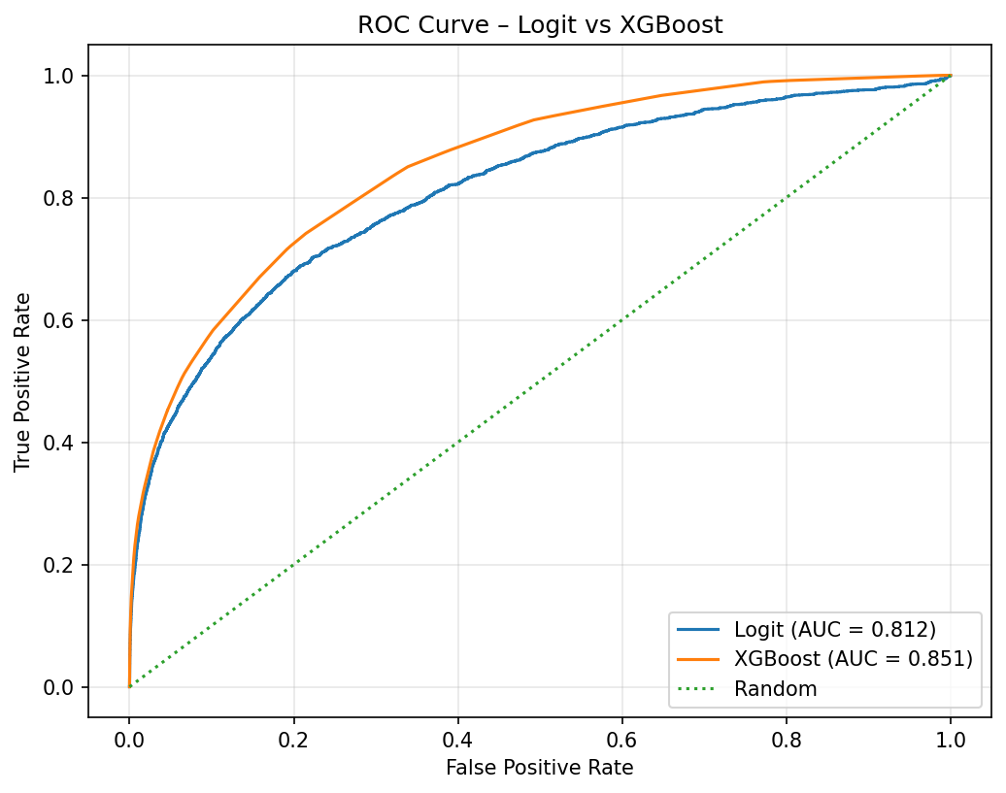
Figure 7 : ROC Curve Between the Baseline Logit Model and XGBoost Model

Slide 36
Developing a Business Case & ROI
A precise business case is now possible because our model provides a calibrated Probability of Default (PD), not just a simple "high/low" ranking. This PD is the exact, data-driven input Banca Massiccia needs for its core financial and risk calculations.
1. Loss Avoidance (Direct Cost Savings) This is the most direct ROI calculation. The bank can now quantify the total Expected Credit Loss (ECL) it will avoid on new loans.
Methodology: The bank should use the standard regulatory formula: ECL=PD×LGD×EAD
How Our Model Enables This:
Our model provides the PD (Probability of Default), which is the most difficult variable to estimate.
The bank already knows its own LGD (Loss Given Default) and EAD (Exposure at Default) for each loan.
ROI Calculation: The bank can run all new applications through our model. By summing the total ECL for all the high-PD loans that the current system would have approved, they can project the exact "annual loss avoided."
2. Risk-Based Pricing (Revenue Growth) Our calibrated PD allows the bank to stop one-size-fits-all pricing and adopt a dynamic, risk-based strategy.
Methodology: Integrate the PD directly into the interest rate pricing formula.
ROI Calculation:
Attract New Low-Risk Clients: The Edelberg paper shows that when default risk (PD) decreases, lenders can (and do) charge lower rates which supports offering more competitive rates to low-PD borrowers.
Increase Profitability on Risk: For medium-risk borrowers, the bank can charge a specific "risk premium" (e.g., Base Rate + PD + Profit Margin) to ensure each loan is priced to be profitable, even after accounting for the expected loss.

Slide 37
Developing a Business Case & ROI
3. Operational Efficiency (Direct Cost Savings) Our harness.py script automates the entire scoring and preprocessing pipeline, reducing manual labor.
Methodology: Measure the change in "underwriting time per application" before and after the model's implementation.
ROI Calculation: The bank can calculate (Time Saved per Application) × (Average Underwriter Hourly Cost) × (Total Applications per Year). This provides a direct, annual cost saving from improved labor efficiency.
4. Proactive Portfolio Monitoring (Loss Mitigation) The model provides a powerful early warning system by re-scoring the entire existing portfolio annually.
Methodology: Identify existing clients whose PD score jumps significantly (e.g., from 1.5% to 4.5%). These clients are flagged for proactive review by the "work-out" group.
ROI Calculation: This is a risk-mitigation value. The ROI is the increased recovery rate achieved by the work-out group before a client defaults, which is historically much higher than intervening after a default.

Slide 38
07
Deployment
Section Overview
Deployment Pipeline: We will show how the harness.py script acts as the final production-ready tool, using the saved joblib and meta.json artifacts to generate predictions on new data.
Key Deployment Issues: Discussing the critical legal and ethical considerations, primarily model explainability for regulators and potential biases (e.g., against smaller firms).
Model Scope & Limitations: To define exactly where this model must not be used, such as on finance/insurance firms , firms under €1.5M in assets, or in different economic regions.
Risk & Mitigation Plan: Correctly identify the main deployment risks, like model drift, and our mitigation strategy, which includes a human-in-the-loop process and a plan for continuous monitoring and retraining.

Slide 39
How the Model Will Be Deployed
Deployment is designed to be simple, robust, and consistent, using the harness.py script as the single point of entry. The process ensures that the exact same preprocessing steps are applied at prediction time as were used in training.
The Deployment Artifacts (artifacts/ dir): The estimator.py script has created a bundle of three essential files:
model.joblib: The trained and finalized XGBoost model.
calibrator.joblib: The fitted Isotonic Regression calibrator.
meta.json: This critical file stores all parameters from training: the full feature list, and all preprocessing values (e.g., the 1st/99th percentiles, means, and standard deviations).
The Prediction Pipeline: When the bank needs to score a new set of borrowers, they will call: python harness.py --input_csv <new_borrowers.csv> --output_csv <predictions.csv>
This command triggers the following automated steps:
Load: harness.py loads the new input CSV.
Call Predictor: It passes the new DataFrame to the predict_pd function.
Load Artifacts: predict_pd loads model.joblib, calibrator.joblib, and meta.json.
Transform: It uses the Preprocessing_Pipeline and the saved parameters from meta.json to transform the new data without re-fitting. This prevents data leakage and ensures consistency.
Predict Score: The transformed data is fed into model.joblib to get the raw XGBoost score.
Calibrate PD: The raw score is fed into calibrator.joblib to get the final, accurate PD.
Save Output: The harness saves these final probabilities as a single n×1 vector, as required by the project instructions.

Slide 40
Ethical and Legal Considerations
Legal (Regulation & Explainability):
This model is being deployed in the EU, which has strict regulations (like GDPR) on automated decision-making. The bank must be able to explain why a borrower received a high-risk score, especially if it leads to a loan denial or a higher interest rate.
While our XGBoost model is complex, its reliance on tangible financial ratios (e.g., leverage_w, cfroa_w) makes it more explainable than models using non-intuitive features. We must use post-hoc techniques (like partial dependence graphs) to provide this required transparency.
Ethical (Bias):
The model is statistically "biased" by design, based on the data we were given. It is only trained on firms with > €1.5MM in assets.
This is an ethical and business limitation: the model will inherently associate the characteristics of smaller firms (which are not in the training set) with higher risk or may fail entirely. It must not be used to make automated "deny" decisions for small businesses, as it has no data to support that judgment.
We have mitigated other biases by not using features like HQ_city or ateco sector directly, which could unfairly penalize firms based on location or industry.
Notes:
(Source: Italian Business Register italianbusinessregister.it/en/annual-accounts)

Slide 41
Risks Associated with our Proposed Plan and Ways to Mitigate them.
1. Risk: Model Drift
Problem: The economy changes, and model performance will degrade over time as the data from 2000-2012 becomes obsolete.
Mitigation: Continuous monitoring of AUC/Brier score and a planned annual retraining schedule using estimator.py.
2. Risk: Over-reliance (Automation Bias)
Problem: Loan officers may blindly trust the model, especially on "gray area" loans.
Mitigation: Implement as a "Human-in-the-Loop" decision-support tool, not a fully automated decider.
3. Risk: Data Quality Failure
Problem: "Garbage in, garbage out." New data that doesn't match the training data's format or quality will cause failures.
Mitigation: Our harness.py and meta.json artifacts create a consistent, locked-down preprocessing pipeline.
4. Risk: Out-of-Scope Misapplication
Problem: Using the model on firms that are not similar to the ones it was trained on (e.g., small businesses, finance firms).
Mitigation: Strict model governance and documentation to enforce that the model is only used on non-financial Italian firms with > €1.5M in assets
Notes:
(Source: Italian Business Register italianbusinessregister.it/en/annual-accounts)

Slide 42
Settings Where Results Should NOT Be Applied
The model's scope is very specific. Applying it outside of this scope will lead to dangerously inaccurate predictions.
Different Firm Types: The model was trained only on non-finance/insurance firms. It must NOT be used to score banks, hedge funds, or insurance companies, as their balance sheets have a completely different structure.
Different Firm Sizes: The training data excludes firms with < €1.5MM in assets. The model must NOT be used for small businesses, startups, or sole proprietorships.
Different Geographies: The model is trained on Italian firms. The financial relationships it learned are specific to the Italian economy and regulatory environment. It must NOT be deployed in other countries (e.g., Germany or the US) without being completely retrained on local data.
Different Loan Products: The model predicts a 12-month default event. It must NOT be used for other products, such as 30-day trade financing, revolving credit lines, or 5-year mortgages, which have different risk horizons

Slide 43
TEAM LAVENDER CONTRIBUTIONS APPENDIX
MUSTAFA POONAWALA (msp9471) - Lead Responsibilities:
• Section 2: Problem Formulation (target definition, temporal structuring, feature engineering strategy)
• Section 3: Data Understanding (EDA, data quality analysis, bias assessment, visualization suite)
• Section 4: Data Preparation (preprocessing pipeline, accounting reconstructions, 19→12 feature selection)
• Technical: XGBoost architecture, hyperparameter optimization, walk-forward validation framework
• Code: preprocessing.py (50%), estimator.py (60%), default_flag.py (100%), harness.py(30%)
YASH JADHAV (yj3076) - Lead Responsibilities:
• Section 5: Modeling (two-stage pipeline design, algorithm comparison, economic intuition analysis)
• Section 6: Evaluation (walk-forward methodology, bootstrap CI, benchmark analysis, ROC curves)
• Section 7: Deployment & Business Case (ROI calculation, risk mitigation, deployment pipeline, ethics)
• Technical: Isotonic calibration research/implementation, bootstrap methodology, 3-way data split
• Code: preprocessing.py (50%), predictor.py (100%), harness.py (70%).estimator(40%)
JOINT CONTRIBUTIONS (Equal Collaboration):
• Section 1: Business Understanding (three-problem framework, regulatory context, stakeholder analysis)
• Literature Review: Financial theory integration (Altman, Ohlson, Beaver), ACPMIP methodology
• Presentation: All slide design, narrative flow, figures, executive summary, final integration
• Model Selection: Algorithm evaluation, validation strategy, calibration approach, hyperparameter tuning
• Quality Assurance: Code review, testing, debugging, documentation, final deliverable review

Slide 44
References
Academic Literature - Finance:
[1] Altman, E. I. (1968). Financial ratios, discriminant analysis and the prediction of corporate bankruptcy. The Journal of Finance, 23(4), 589-609.
[2] Beaver, W. H. (1966). Financial ratios as predictors of failure. Journal of Accounting Research, 4, 71-111.
[3] Ohlson, J. A. (1980). Financial ratios and the probabilistic prediction of bankruptcy. Journal of Accounting Research, 18(1), 109-131.
Academic Literature - Machine Learning:
[4] Lessmann, S., Baesens, B., Seow, H. V., & Thomas, L. C. (2015). Benchmarking state-of-the-art classification algorithms for credit scoring: An update of research. European Journal of Operational Research, 247(1), 124-136.
[5] Elkan, C. (2001). The foundations of cost-sensitive learning. International Joint Conference on Artificial Intelligence, 17(1), 973-978.
Industry References:
[6] Morini, M. & Ruiz, A. (Eds.). (2010). Active Credit Portfolio Management in Practice. Wiley Finance.
- Chapter 4 (pp. 215-226): Calibration methodology
- Chapter 7 (pp. 380-392): Model validation
[7] Edelberg, W. (2006). Risk-based pricing of interest rates in household loan markets. Journal of Monetary Economics, 53(8), 2283-2298.
Regulatory Framework:
[8] International Financial Reporting Standards (IFRS) 9: Financial Instruments (2014). International Accounting Standards Board.
[9] Basel Committee on Banking Supervision (2017). Basel III: Finalising post-crisis reforms. Bank for International Settlements.
[10] https://italianbusinessregister.it/en/annual-accounts

Slide 45
Thank You
Any questions?
youremail@freepik.com
+91 620 421 838
yourwebsite.com
Please keep this slide for attribution

